Slide 1
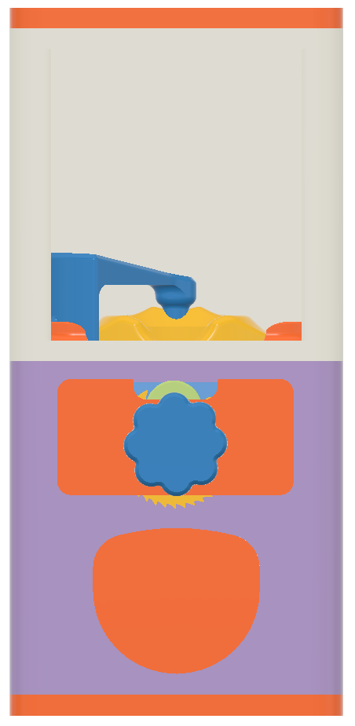
Front View
Lid
Top Chamber
Hole Blocker
Mid-Plate
Main Gear
Coin Mech. Back Plate
Coin Mech. Front Plate
Coin
Knob
Coin Mech. Gear
Mouth
Bottom Plate

Slide 2
Front View

Slide 3
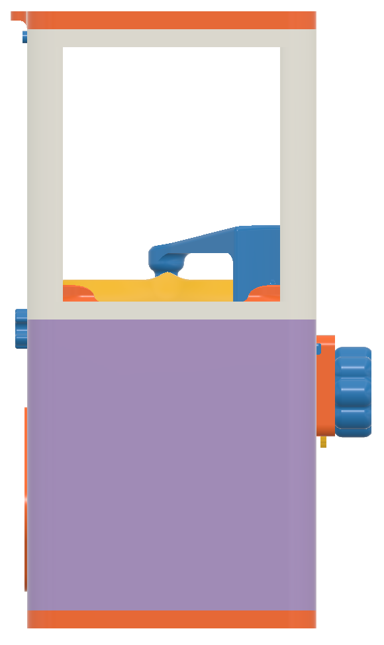
Left Side View - Clear Windows
Lid
Lid Lock
Top Chamber
Hole Blocker
Mid-Plate
Main Gear
Coin Mech. Front Plate
Knob
Coin Mech. Gear
Bottom Chamber
Rear Lock Knob
Bottom Plate

Slide 4
Left Side View - Clear Windows

Slide 5
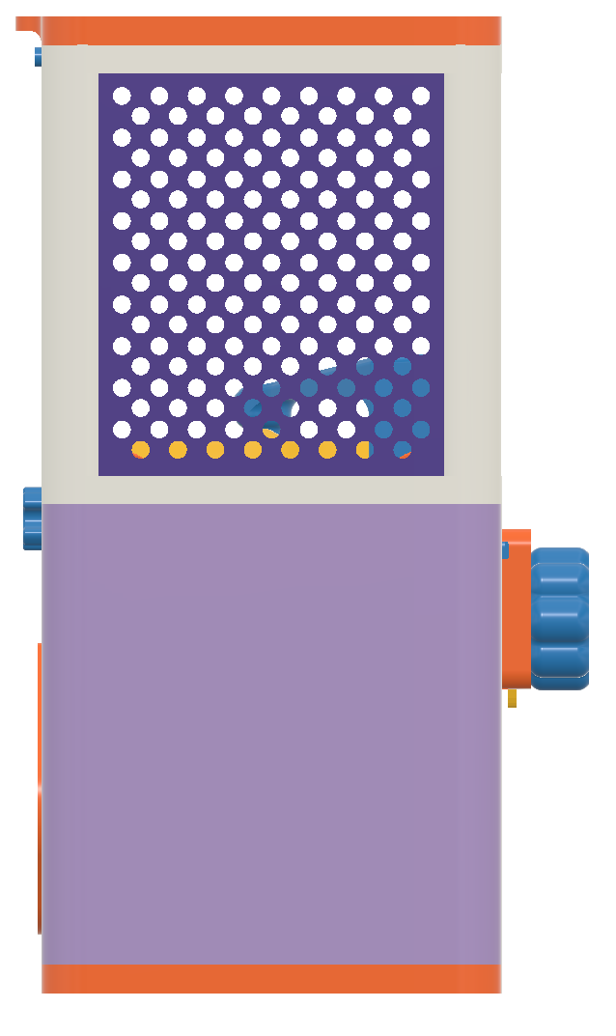
Left Side View - 3D Printed Windows
Lid
Lid Lock
Top Chamber
Window
Hole Blocker
Mid-Plate
Main Gear
Coin Mech. Front Plate
Knob
Coin Mech. Gear
Bottom Chamber
Rear Lock Knob
Bottom Plate

Slide 6
Left Side View - 3D Printed Windows

Slide 7
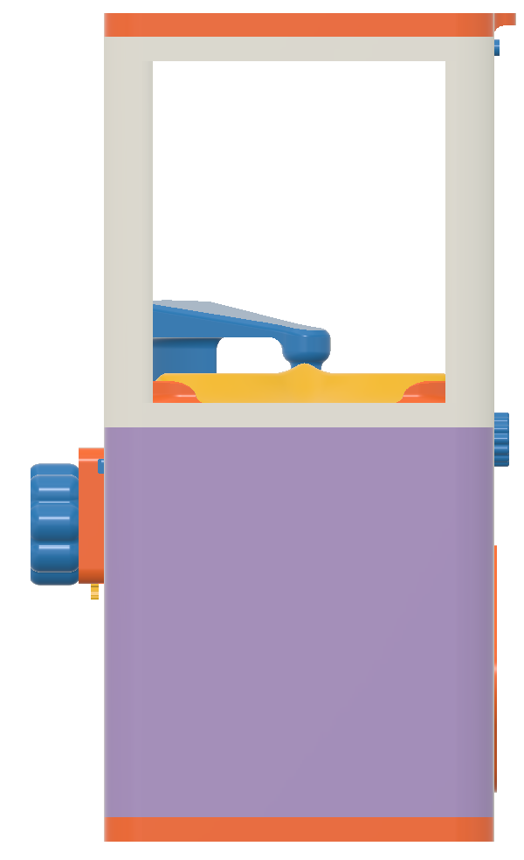
Right Side View - Clear Windows
Lid
Lid Lock
Top Chamber
Hole Blocker
Mid-Plate
Main Gear
Coin Mech. Front Plate
Knob
Coin Mech. Gear
Bottom Chamber
Rear Lock Knob
Bottom Plate

Slide 8
Right Side View - Clear Windows

Slide 9
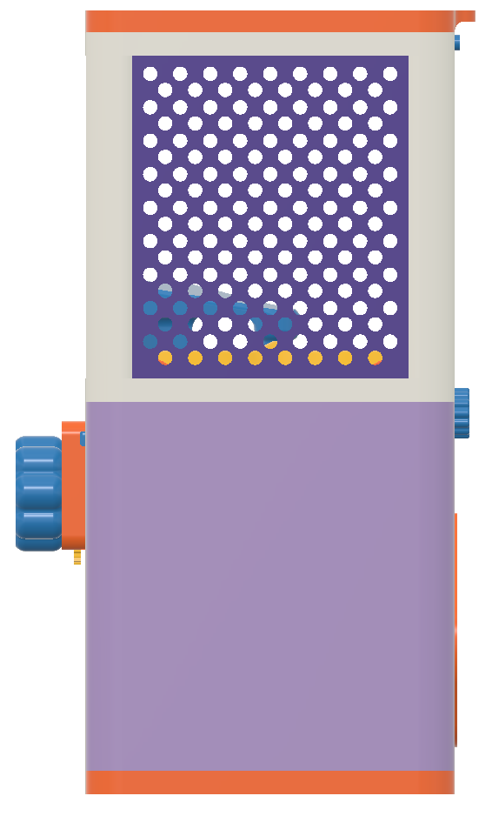
Right Side View - 3D Printed Windows
Lid
Lid Lock
Top Chamber
Window
Coin Mech. Front Plate
Knob
Coin Mech. Gear
Bottom Chamber
Rear Lock Knob
Bottom Plate

Slide 10
Right Side View - 3D Printed Windows

Slide 11

Rear View
Lid
Lid Lock
Top Chamber
Rear Lock Knob
Bottom Chamber
Back Cover
Bottom Plate

Slide 12
Rear View

